Slide 1
Making this resource work for you
Prior to teaching this lesson, please refer to the ‘Unit Overview and Planning Document’.
Further guidance on planning Science Mastery lessons can be found in the detailed planning guidance document.
Refer to the ‘notes’ section on each slide for useful information, including suggested expositions, pedagogical content knowledge, suggested questions, answers and more. Consider using presenter mode so you can see this guidance throughout the lesson.
The introduction slides can be adapted to suit your teaching style and the needs of your class.
Before the lesson, adapt the fix-it slide to address any misconceptions identified in the previous lesson’s exit ticket.
Choose from the suggested activities to suit your class. The intention is not that you complete all of these, but that you select those which ones are most appropriate for your students. It may be appropriate to further adapt activities for your students.
These lessons are designed to occupy approximately 1 hour. To adapt for a shorter or longer lesson duration we advise you to adapt the activity section accordingly.
Please consider using the final slide to send feedback about this lesson or examples of PowerPoints that you have adapted to our design team. Your feedback is used to improve Science Mastery for all of our teachers and students. We appreciate all suggestions and comments.
Thank you for reading!
The Science Mastery Team

Slide 2
Prior Knowledge Review
Answer the questions below.
Name the three states of matter.
Name the process by which a solid becomes a liquid.
In which state of matter do particles have the greatest internal energy?
Define internal energy.
Describe the four different pathways by which energy can be transferred.
Solid, liquid, gas
Melting
Gas
The sum of all the kinetic and potential energy of all the particles in a system.
Mechanically, electrically, by radiation or by heating
Notes:
Big idea: Energy is conserved
Foundation: In which state of matter are particles able to move most freely?
Stretch: Explain the difference between the arrangement of particles in a solid and a gas.
Answers:
Foundation: Gas
Stretch: Particles in a solid are held together in a regular lattice arrangement because they do not have enough energy to overcome the forces of attraction, whereas in a gas the particles have enough energy to overcome the forces, so particles are able to move freely in all directions.

Slide 3
Prior Knowledge Review
Do Now:
Name the three states of matter.
Name the process by which a solid becomes a liquid.
In which state of matter do particles have the greatest internal energy?
Define internal energy.
Describe the four different pathways by which energy can be transferred.
Drill:
State the SI unit for energy.
State the SI unit for mass.
Convert 10 mL into SI units.
Notes:
Drill answers
Joules
kilograms
0.01 L

Slide 4
Prior Knowledge Review
Read Now:
Matter is one of the most fundamental ideas in science. Matter is anything that has mass and takes up space, no matter how tiny their mass or the space they take up. All matter is made up of particles but can exist in different states. The three states of matter are solids, liquids and gases and matter can change between these states if energy is transferred or removed from its system. When a substance changes state, the particles it is made of remain the same, but the spacing between them and their movement changes. This is why changes of state are physical changes not chemical reactions.
Define matter.
Name the three states of matter.
Describe how a substance can change state.
Describe what happens to the particles when a substance changes space.
Explain the difference between a physical change and a chemical reaction.

Slide 5
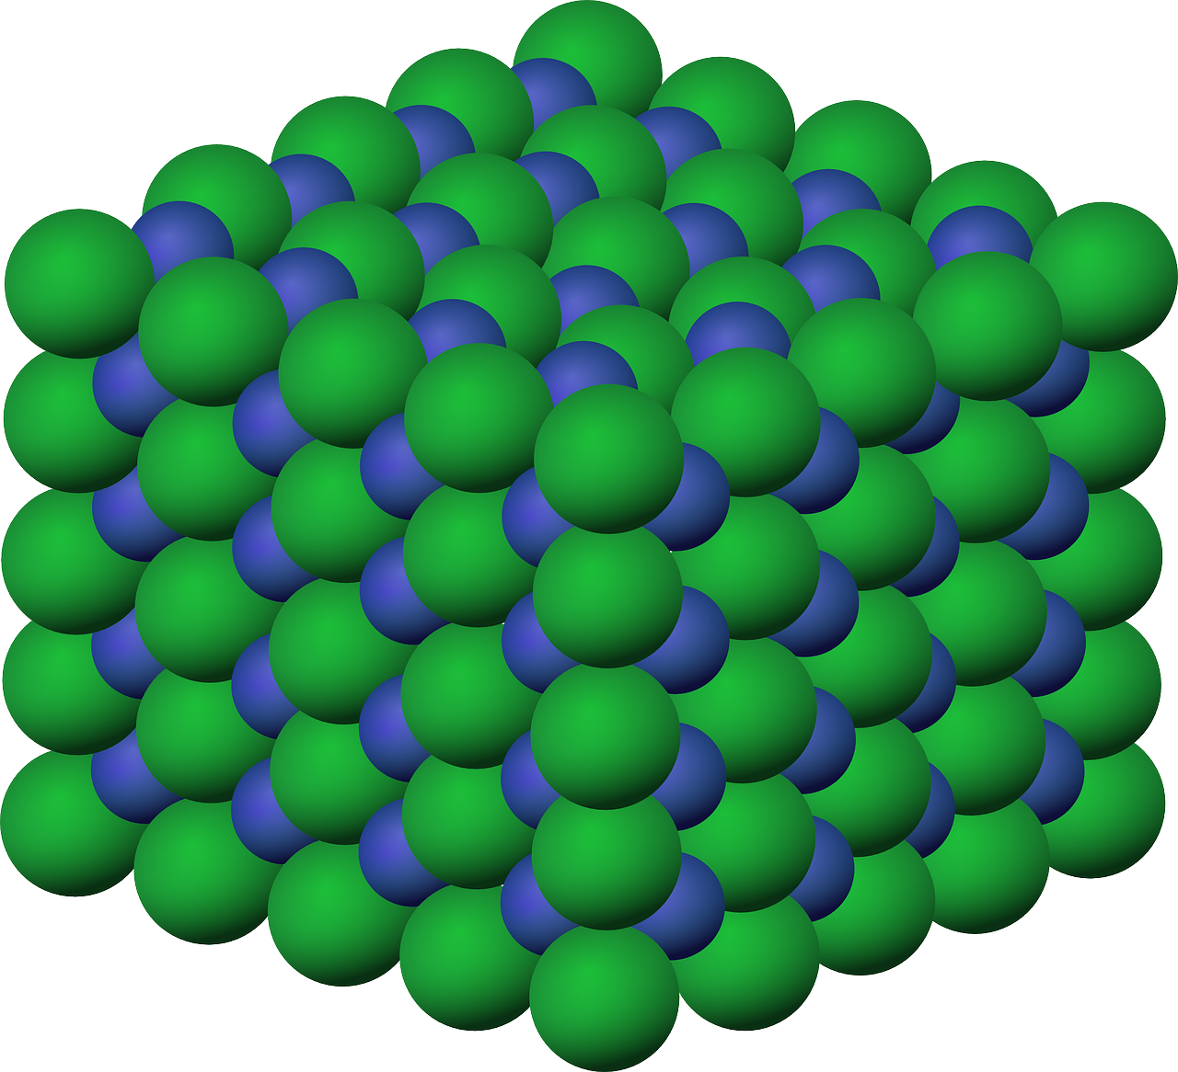
P4.1.1
09/10/2023
Prior Knowledge Review
P4.1.1 Prior Knowledge Review
P4.1.2 Density
P4.1.3 Measuring Density
P4.1.4 Gas Pressure
P4.1.5 Taking it Further: Pressure
P4.1.6 Taking it Further: Pressure in Fluids
Notes:
Big Idea: Energy is Conserved.
This unit will cover the particle model, density and pressure.
Suggested Hook:
To make the most of this review lesson, it is worth using the pre-unit quiz or starting with a classic misconception question such as ’draw a particle diagram of air, what is between the air particles’?

Slide 6

Following this lesson, students will be able to:
Draw particle models to represent the arrangement of particles in each state of matter
Compare and explain the arrangement and movement of particles in each state of matter
Key Words:
matter
state
particle diagram
forces of attraction
Notes:
Guidance:
See unit overview document and planning guidance to see how these objectives are typically assessed at GCSE, including examples of what students should be able to do following this lesson.
Planning for different needs:
The learning objectives given on this slide are suggested based on the most common requirements for exams, however they can be adapted based on the needs of different classes.
For best practice, the unit preparation booklet should be used to determine the appropriate focus of lessons within the unit.
While it is not possible to explicitly split content into levelled grades, we recommend that lesson objectives can be classified as critical, core or stretch.
Critical: the content or skill is essential for all students to be able to progress.
Core: the content or skill is important for students to progress, but other opportunities may be available to revisit it.
Stretch: the content or skill may not be essential for all students but is important for students aiming for the highest grades.
Key skill: this is a crucial skill being developed in this unit as part of the skill mapping
P4.1.1 Lesson Objectives:
Critical: Draw particle models to represent the arrangement of particles in each state of matter
Critical: Compare and explain the arrangement and movement of particles in each state of matter

Slide 7
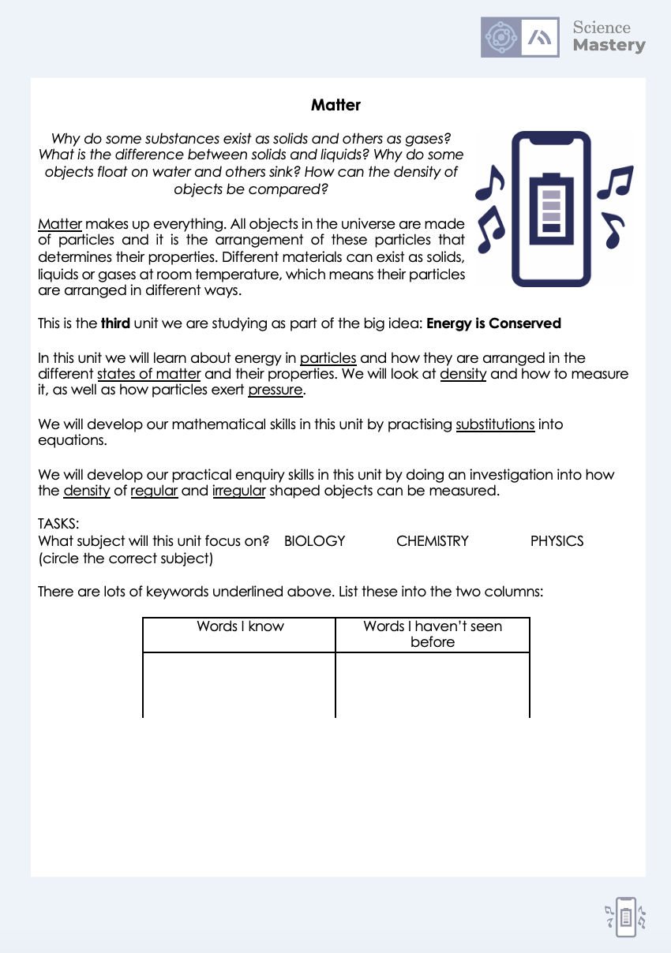
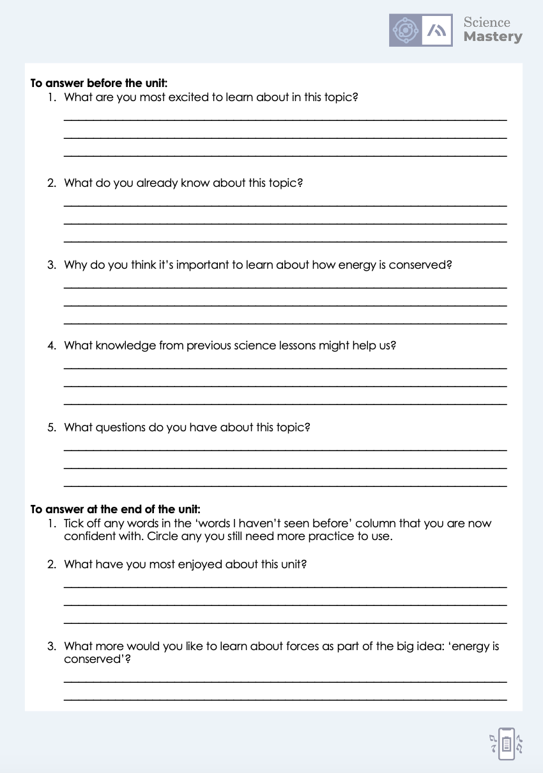
The Big Idea: Energy is Conserved
Notes:
Purpose:. The purpose of this resource is to provide students with an overview at the beginning and end of each unit. It is designed to create a discussion about the unit prior to the sequence of lessons.
Teacher guidance:
Pupils should be directed to the P4.1 Link to Big Ideas worksheet (either in their booklet or printed).
Teachers should use guided reading techniques to read aloud with the pupils. Tier 3 vocabulary has been highlighted. (It may need to be adapted further for LPAs or pupils with different reading ages.)
Questions on the student sheet:
1. What are you most excited to learn about in this topic?
2. What do you already know about this topic?
3. What is matter?
4. Why do you think it’s important to learn that our bodies are systems?
5. What knowledge from previous science lessons might help us?
6. What questions do you have about this topic?
There are a range of ways to use this resource:
1. Display on a slide for students to read as a class. Direct students to complete the activities in their book.
2. Print off for students to stick into their book at the beginning of the unit along with their knowledge organiser. Complete as a guided reading task together. Direct students to complete the activities.
3. Have students complete as part of a booklet.
Set as a homework prior to a unit.
If you have any feedback about how this resource could be used/improved, please contact the science mastery team: sciencemastery@arkonline.org

Slide 8
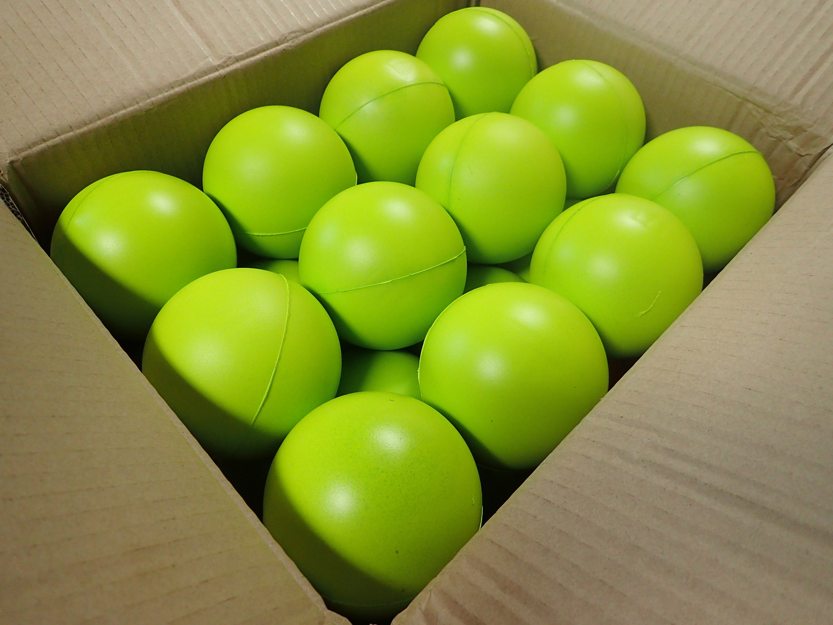
How can we explain the properties of solids, liquids and gases?
Solid
Liquid
Gas
Notes:
This is a review from C1.1.
Exposition type: Explanation and Modelling
Suggested teacher exposition:
If you were to zoom in on any material you would see something that looks roughly like this. Display the first diagram. These circles represent the tiny tiny particles that make up all matter (or all stuff!). They look like flat circles here, but in reality imagine this diagram in 3D, so these are like little balls. Support the diagram with a real model. A good one is a box with lots of ping pong balls or other small balls, use the image if you do not have a real life model to show. This can be used throughout the explanation to support the description of this model.
Which state of matter do you think might be represented by this first diagram? Solid. Why? The ‘particles’ are arranged in a regular structure. They are tightly packed together. They cannot move, apart from being able to vibrate in position. Model this using the box of balls. Show that the particles are not still – they are vibrating, however they are still staying in position. They are arranged in a regular arrangement. Each particle touches its neighbours. They don’t look to have a lot of energy (they’re not moving around a lot).
Ok, now what is different in the second diagram, the liquid? The particles are not in a regular arrangement. They are arranged more randomly. Model the liquid using the box of balls. Show how the liquid particles can ’flow’ over each other. They have more energy that the solid particles. What is the same between the solid particle diagram and the liquid particle diagram? In both, the particles are always touching their neighbours. The liquid particles can flow over one another, but they are still always touching. And we can see this in the particle diagram, and in the box of balls. There aren’t any balls floating in the air! This is one of the most common mistakes that students make when drawing a liquid particle diagram.
Finally, we come to the gas particle diagram. What do we notice here? The particles are spread out. They are moving with lots of energy. They are arranged in a completely random arrangement.
What do you think is in the spaces between those gas particles? Lets say the particles are showing the air in a room. Nothing! Can you explain why the answer to that questions isn’t air? Because air itself is made of particles!
Don’t forget that the particles themselves in a solid, liquid and gas are the same. The only thing that changes is how the particles are arranged. So if I had solid water (ice), the particles would look like this. Now if that ice melts to make liquid water, the particles themselves are the exact same particles, they just now are arranged like this. And it that water was heated and turned into a gas (or steam), now those same particles would be arranged like this.
Key Points to emphasise: All the particles are the same size in this model. In reality this might not be the case. The particles do NOT change in solid, liquid and gases. There is NOTHING between particles – not air – NOTHING! All these particles are moving to a greater or lesser extent. There are a number of ways that you could demonstrate this. You could use the phet Colorado link (https://phet.colorado.edu/sims/html/states-of-matter-basics/latest/states-of-matter-basics_en.html) or you could get a group or students/ whole class to model this with their bodies.
Whichever way you choose, you will want to review the following points. You may be able to use questioning for pupils to arrive at these answers together.
Solid
The particles are very close together and touch their neighbours.
They are in a regular arrangement.
Particles vibrate on the spot.
Particles have the least energy
Liquid
The particles are close together and touch their neighbours.
They are not in a regular arrangement.
Particles move around, sliding over each other.
Particles have the an intermediate amount of energy .
Gas
The particles spread out.
The particles move fast throughout the whole container.
They are in a random arrangement.
Particles have the most energy.
Image source: Pixabay

Slide 9

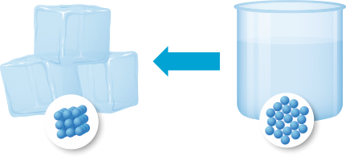
What happens to the particles when a solid melts?
When a solid melts the particles gain energy from the surroundings, so they begin to vibrate faster.
The particles move away from their places in the arrangement and start to move around more.
Notes:
Exposition type: Demonstration
Suggested teacher exposition:
So now we know what melting is (the change of state from a solid to a liquid). Now, we want to find out what is actually happening to the particles as a solid melts.
Use a particle model, such as ping pong balls in a box. These should be tightly packed in a regular arrangement to model solid particles. Shake the box rapidly to cause the balls to vibrate.
Here we have the solid particles vibrating. Now as we supply energy to the particles (say, by heating them), these particles will gain energy. Shake the box more until they are no longer in the regular arrangement.
What state of matter do you think this represents now? A liquid
Why? The particles are no longer arranged in a regular way, and can move more freely over one another.
The particles have more energy and can move around more. They have overcome some of the forces of attraction.
Are they still touching each other? Yes
They are still in the bottom of this container. They still have a fixed volume. However they no longer have a fixed shape. This substance has changed state from a solid to a liquid – we say it has melted.
Have the particles themselves changed, or are they the same? They are the same.
We don’t have ‘solid’ particles that change to ‘liquid’ particles – that’s a common misconception that people have. Actually, they particles themselves don’t change – it’s just their arrangement does, and the amount of energy the particles have.
Image source: Pixabay

Slide 10
Melting and Boiling Points
80 ∘C
The melting point is the temperature at which a solid changes state into a liquid.
Why are some substances liquid at room temperature but others are solid?
60 ∘C
40 ∘C
Liquid water
1. What state is water at 65 ∘C?
Liquid
20 ∘C
2. What state is water at -10 ∘C?
Solid
0 ∘C
Melting point of water
3. What state is water at 1 ∘C?
Liquid
Solid water (ice)
-20 ∘C
Notes:
Suggested teacher exposition:
One thing that you will need to be able to do is say what state a substance is at a certain temperature.
So water for example, at some temperatures will be a liquid. Room temperature is between 20-24 degrees Celsius, and water is liquid. But if I were to turn down the temperature so that the room was -5 degrees Celsius, what state would water be in then?
It would be a solid.
How do you know?
Because the melting point of water is 0 degrees Celsius.
We can follow these rules for any substance! If we know the melting point, we can tell what if that substance will be solid or liquid at any given temperature. Remember, the warmer the substance gets, the more energy its particles will have.
It’s important to remember that all substances have different melting points. Water has a melting point of 0 degrees Celsius, but other substances have a different melting point, for example, oxygen has a melting point of -218 degrees Celsius. That means that if you cooled oxygen below that temperature it would be solid!
The melting point can also be called the freezing point.
Teacher guidance:
This is also an excellent opportunity to discuss negative numbers. You could use the number line to explore what the temperature would be when water gets warmer and cooler from it’s melting point. For example, what would the temperature be if you cooled water down by 20∘C from it’s melting point? What would you expect to see in the beaker? How would the particle arrangement change? And similar questions for warming, particularly from negative numbers. Calculations that force students to cross 0 on the number line could be challenging so keep referring back to the number line and be really strict on the use of the '–' symbol in full answers.

Slide 11
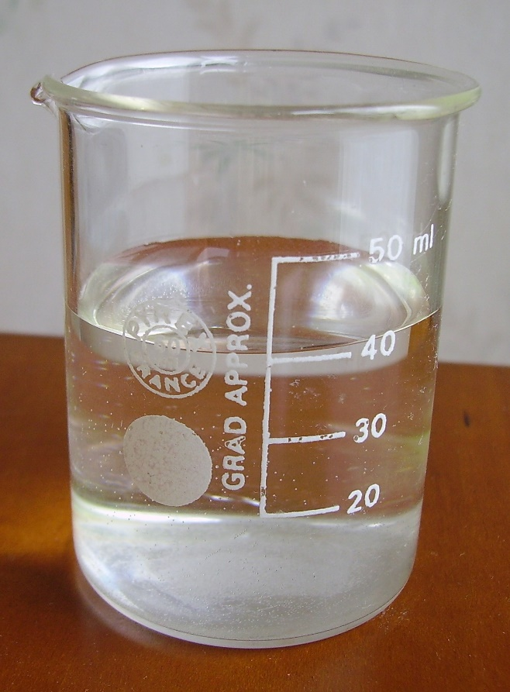
Internal Energy
Particles in solids, liquids and gases have a store of kinetic energy because the particles are always moving or vibrating.
Particles also have a store of potential energy because their motion keeps them separated.
Internal energy is the total amount of kinetic energy and potential energy of all the particles in a system.
Notes:
This is a review from P3.2.
Exposition type: explanation
Suggested Script:
Particles are always moving or vibrating – even when the macroscopic object is ‘standing still’. A tennis ball flying through the air has kinetic energy, but even when it has landed and stopped moving the particles that make up the ball still have their own kinetic store of energy. Internal energy means the energy of the particles inside the system – not the energy of the object / substance as a whole.
It can be helpful to use the analogy of a spring to explain potential energy: if you stretch a string it has the potential to snap back, and it takes energy to stretch and keep it stretched. In a similar way it takes energy to separate particles because of the forces of attraction between them, and they have the potential to move back together if that energy is lost
Internal means ‘inside something’ so it is the total energy inside a system. The internal energy of this water is a measure of the total amount of kinetic energy in all of the particles and the total amount of potential energy of all the particles.
Notes:
Follow the IoP guidance regarding the use of language surrounding energy in terms of stores (see below). Most students will discuss the energy in the system in terms of kinetic energy and the movement of the particles. Make sure students are not using the term ‘types of energy’.
Ideas for the lesson from: https://thescienceteacher.co.uk/internal-energy/
The following guidance from BEST is also useful:
https://www.stem.org.uk/sites/default/files/pages/downloads/BEST_Article_Teaching%20energy.pdf
From IoP sparks https://spark.iop.org/helpful-language-energy-talk
It is helpful to talk about energy stores. A spring, or a rubber band, can rather obviously store energy. You do work to stretch them (or to squash the spring), and you can get back pretty much the same amount of energy when they relax. These then are two of the best iconic examples for grasping what ‘potential energy’ is all about. It is energy in a mechanical store. There are a limited number of energy stores (of which the first five have been introduced in P1.3):
chemical (e.g. fuel + oxygen)
kinetic (in a moving object)
gravitational (due to the position of an object in a gravitational field)
elastic (e.g. in a stretched or compressed spring)
thermal (in a warm object)
magnetic (in two separated magnets that are attracting, or repelling)
electrostatic (in two separated electric charges that are attracting, or repelling)
nuclear (released through radioactive decay, fission or fusion)
Energy carriers (or pathways) and energy transfers
It is often helpful to think of energy being carried from one place to another. For example, light carries energy from the Sun to the Earth. Light is not itself ‘energy’ – it is after all an electromagnetic wave, or a stream of photons (however you care to look at it). But energy does travel with the light. The same is true of radio waves. In a microwave oven microwaves carry energy from the microwave generator to the interior of the food. Other kinds of waves carry energy too, for example ocean waves.
Electric current in a circuit is another energy carrier. It is helpful to think about a power circuit as a way of moving energy from one place to another. The National Grid distributes energy from a number of power stations, via the wires and cables, to homes and factories.
It is often handy to think of moving matter as carrying energy, too. A strong wind delivers energy to a wind turbine. But, equally often, it is better to think of the moving mass as storing energy. A train has to be given energy to get it moving, and energy has to be taken from the train to stop it. This is what we call kinetic energy.
Energy carriers (or pathways, or transfers)
mechanically (when a force moves through a distance)
electrically (when a charge moves through a potential difference)
by heating (because of a temperature difference)
by radiation (e.g. light, microwaves, sound)
With all of these, we are interested in the rate at which energy is being transferred and not the amount stored anywhere.
Image source
https://commons.wikimedia.org/wiki/File:Water_in_a_beaker.JPG

Slide 12
Internal Energy
The hotter a material is, the faster its particles move and therefore the larger the store of kinetic energy.
The further apart the particles are from one another, the larger their store of potential energy (related to their state: solid, liquid, gas).
The temperature of a substance is related to the average kinetic energy of each particle.
Notes:
Purpose: to introduce new learning.
Internal means ‘inside something’ so it is the total energy inside a system.
You may want to revisit the meaning of a system - an object or group of objects. In the above image the system is the beaker of water.
The hotter a material is, the faster its particles move and the larger the store of kinetic energy
The further apart the particles, the larger the store of potential energy
Follow the IoP guidance regarding the use of language surrounding energy in terms of stores (see below). Most students will discuss the energy in the system in terms of kinetic energy and the movement of the particles. Make sure students are not using the term ‘types of energy’.
Ideas for the lesson from: https://thescienceteacher.co.uk/internal-energy/
Notes: From IoP sparks https://spark.iop.org/helpful-language-energy-talk
It is helpful to talk about energy stores. A spring, or a rubber band, can rather obviously store energy. You do work to stretch them (or to squash the spring), and you can get back pretty much the same amount of energy when they relax. These then are two of the best iconic examples for grasping what ‘potential energy’ is all about. It is energy in a mechanical store. There are a limited number of energy stores:
chemical (e.g. fuel + oxygen)
kinetic (in a moving object)
gravitational (due to the position of an object in a gravitational field)
elastic (e.g. in a stretched or compressed spring)
thermal (in a warm object)
magnetic (in two separated magnets that are attracting, or repelling)
electrostatic (in two separated electric charges that are attracting, or repelling)
nuclear (released through radioactive decay, fission or fusion)
Energy carriers (or pathways) and energy transfers
It is often helpful to think of energy being carried from one place to another. For example, light carries energy from the Sun to the Earth. Light is not itself ‘energy’ – it is after all an electromagnetic wave, or a stream of photons (however you care to look at it). But energy does travel with the light. The same is true of radio waves. In a microwave oven microwaves carry energy from the microwave generator to the interior of the food. Other kinds of waves carry energy too, for example ocean waves.
Electric current in a circuit is another energy carrier. It is helpful to think about a power circuit as a way of moving energy from one place to another. The National Grid distributes energy from a number of power stations, via the wires and cables, to homes and factories.
It is often handy to think of moving matter as carrying energy, too. A strong wind delivers energy to a wind turbine. But, equally often, it is better to think of the moving mass as storing energy. A train has to be given energy to get it moving, and energy has to be taken from the train to stop it. This is what we call kinetic energy.
Energy carriers (or pathways, or transfers)
mechanically (when a force moves through a distance)
electrically (when a charge moves through a potential difference)
by heating (because of a temperature difference)
by radiation (e.g. light, microwaves, sound)
With all of these, we are interested in the rate at which energy is being transferred and not the amount stored anywhere.

Slide 13
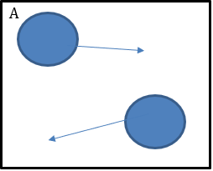
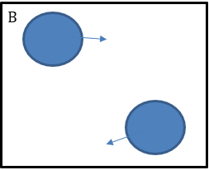
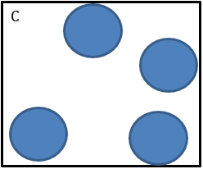
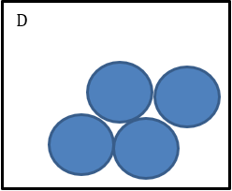
Internal Energy
Which of these images, A or B, shows a larger kinetic energy store? Why?
Which of these images, C or D, shows a larger potential energy store? Why?
A, the particles are moving faster
C, the particles are further apart
Notes:
Purpose: to give pupils an opportunity to discuss their new learning.
Pupils may need a reminder that the length of the arrow represents the relative motion (i.e. longer arrow shows more kinetic energy so a faster moving particle).
Explain the term system in context i.e. in terms of the beaker of water from the previous example. A system is an object or group of objects.
The larger the separation between the particles the larger the potential energy store. The motion of the particles keeps them separated, opposing the forces trying to pull them together. Particles in a gas have the most PE as they are furthest apart. Solid particles are closer together, they need more energy to break the intermolecular forces; therefore have a lower PE.
When atoms oscillate more their average KE increases. The PE of the molecules also changes as they get squeezed closer together and move further apart.
From: http://hyperphysics.phy-astr.gsu.edu/hbase/thermo/inteng.html
Internal energy is defined as the energy associated with the random, disordered motion of molecules. It is separated in scale from the macroscopic ordered energy associated with moving objects; it refers to the invisible microscopic energy on the atomic and molecular scale. For example, a room temperature glass of water sitting on a table has no apparent energy, either potential or kinetic. But on the microscopic scale it is a seething mass of high speed molecules traveling at hundreds of meters per second. If the water were tossed across the room, this microscopic energy would not necessarily be changed when we superimpose an ordered large scale motion on the water as a whole.

Slide 14
Internal Energy
Heating a substance increases its internal energy.
When a substance is heated (when you add energy), the internal energy can change in two ways:
Increase in internal energy
Kinetic energy store increases
State stays the same
Temperature increases
Potential energy store increases
Temperature remains the same
Change in state
Notes:
Purpose: to introduce new learning.
The boxes here explains the two possible outcomes of an increase in internal energy – to be explained to students.
Script:
When a substance changes state, the KE does not increase, the absorbed energy goes into the PE store. The increase in energy is used to weaken/overcome the intermolecular forces to enable a change in state. Once the change in state has occurred any additional heating will continue to increase the energy stored in the kinetic energy store and cause an increase the temperature.

Slide 15




Which statements do you agree with?
When ice melts to form water, the forces of attraction are weakened
When ice melts to form water, the particles expand
When ice melts to form water, the particles react to form a new substance
When ice melts to form water, the particles become more spread out
Notes:
Suggested points:
Blue: incorrect. This is the misconception that particles themselves change during a change of state.
Yellow: correct.
Green: incorrect. This is a confusion between a physical change and a chemical change.
Pink: correct
Suggested guidance:
Talk tasks can be used in a variety of ways to suit the particular needs of the students you are teaching. Through exchanging views with others, students develop their understanding of the science beyond what could be achieved individually.
Science classrooms that successfully integrate talk have the following features:
Science talk is a regular feature of lessons and is woven into classroom activities.
Students are paired or grouped strategically by the teacher to ensure productive interaction. This might take into consideration the students’ proficiency of the English language, how encouraging they might be to peers and their attainment in the topic. It’s a good idea to consider these pairings in the class seating plan.
Students are encouraged and supported to talk, but are not forced to talk.
The teacher should take on the role of a facilitator, engaging with conversations where necessary and encouraging or steering the conversation where needed.
Students are encouraged to use the language they have to express their ideas (e.g., everyday language, imperfect English, native language), but also to incorporate science specific terminology where this is more accurate or has been taught.
6. Scientifically inaccurate ideas are not dismissed by the partner or teacher; open discussion and further investigation are relied on to help students construct ideas that support them to progress in their scientific understanding.
7. Guidelines for behaviour during talk tasks are explicit and frequently reviewed. Rules for students might be:
Listen carefully to your partner
Take turns talking.
Speak one at a time, without interrupting.
Politely agree or disagree and explain why.
Politely point out if your partner has used a scientific word incorrectly, if they have explained the science incorrectly, or if there is a more accurate way to describe something.
If confused, ask questions.
Stay focused on the discussion topic.
Respond to one another.

Slide 16

Can you describe and explain the difference between the properties of these two states of matter?
Solid
What are the properties of each?
What is the arrangement of particles in each?
How do the particles move in each?
What can be said about the energy of particles in each?
How can the properties be linked to the arrangement of particles?
Gas
Notes:
Suggested points:
Solids have a fixed shape and volume, whereas gases take the shape of their container
Particles in a gas can flow, but particles in a solid cannot
Particles in a solid are held in a regular fixed arrangement, but in gases particles are spread far apart
Particles in a solid can only vibrate around their positions, but in gases particles can move freely and quickly in all directions
Particles in a solid cannot overcome the forces of attraction between them, whereas particles in a gas can because they have much more energy
Solids have a fixed shape because the particles are held tightly together, whereas gases can take the shape of the container because the particles can spread out in all directions
Suggested guidance:
Talk tasks can be used in a variety of ways to suit the particular needs of the students you are teaching. Through exchanging views with others, students develop their understanding of the science beyond what could be achieved individually.
Science classrooms that successfully integrate talk have the following features:
Science talk is a regular feature of lessons and is woven into classroom activities.
Students are paired or grouped strategically by the teacher to ensure productive interaction. This might take into consideration the students’ proficiency of the English language, how encouraging they might be to peers and their attainment in the topic. It’s a good idea to consider these pairings in the class seating plan.
Students are encouraged and supported to talk, but are not forced to talk.
The teacher should take on the role of a facilitator, engaging with conversations where necessary and encouraging or steering the conversation where needed.
Students are encouraged to use the language they have to express their ideas (e.g., everyday language, imperfect English, native language), but also to incorporate science specific terminology where this is more accurate or has been taught.
6. Scientifically inaccurate ideas are not dismissed by the partner or teacher; open discussion and further investigation are relied on to help students construct ideas that support them to progress in their scientific understanding.
7. Guidelines for behaviour during talk tasks are explicit and frequently reviewed. Rules for students might be:
Listen carefully to your partner
Take turns talking.
Speak one at a time, without interrupting.
Politely agree or disagree and explain why.
Politely point out if your partner has used a scientific word incorrectly, if they have explained the science incorrectly, or if there is a more accurate way to describe something.
If confused, ask questions.
Stay focused on the discussion topic.
Respond to one another.

Slide 17
Drill
Name the three states of matter.
Name the state(s) of matter which has a fixed shape.
Name the state(s) of matter which has a fixed volume.
Name the state(s) of matter that can be compressed.
Name the state of matter in which particles have the most energy.
Define internal energy.
Describe the two effects that heating can have on a system.
Notes:
Purpose: This is a knowledge drill. The purpose of this is to check that the critical knowledge is secure before pupils move onto independent practice.
Suggested guidance: There are a range of ways this could be done depending on time and ability range of the class:
Mini whiteboards
As full sentences in exercise books
As short answers in exercise books
In the pupil workbook
As pair talk
As cold call

Slide 18
Drill answers
Solid, liquid and gas
Solid
Solid and liquid
Gas
Gas
The total amount of kinetic energy and potential energy of all the particles in a system.
Cause an increase in temperature or a change of state
Notes:
Purpose: This is a knowledge drill. The purpose of this is to check that the critical knowledge is secure before pupils move onto independent practice.
Suggested guidance: There are a range of ways this could be done depending on time and ability range of the class:
Mini whiteboards
As full sentences in exercise books
As short answers in exercise books
In the pupil workbook
As pair talk
As cold call

Slide 19
Draw the particle diagrams for solids, liquids and gases
(3 marks)
Solid
Liquid
Gas
2. Describe the arrangement of particles in
Solids (4 marks)
Liquids (4 marks)
Gases (4 marks)
Include: movement of particles, space between particles, regular or irregular arrangement, energy of particles.
Notes:
Purpose: students practise using and applying their new knowledge. Mark schemes are given where possible for students to self or peer assess work.
Stretch: Use the particle model to explain why liquids and gases can flow but solids cannot.

Slide 20
Mark scheme
Property | Solid (4) | Liquid (4) | Gas (4)
Movement of particles | Vibration around fixed points | Particles flow over one another | Particles move quickly.
Space between particles | Particles are touching | Particles are touching | Particles can have large distances between them and may collide when moving.
Regular or irregular arrangement of particles? | Regular | Irregular | Irregular
Energy of particles | Low | Intermediate | High
What mark would you give to the following answer? Why?
A. The particles in solids are held in a regular fixed position and they are touching. The energy is low so the particles are not moving.
✓
3/4
x
✓
✓
Notes:
Purpose: students practise using and applying their new knowledge. Mark schemes are given where possible for students to self or peer assess work.
Suggested Guidance: This is a mark scheme to support the paragraph writing task.
You may like to take a pupils answer under the visualiser and demonstrate how you will use this mark scheme. There is a model answer here with mark scheme if you do not have a visualizer. You may like to ask pupils to mark this answer first and then check it against the given marks.
Stretch: Liquids and gases can flow because the particles can move over one another in both liquids and gases.

Slide 21

I: Compare: to outline the similarities and/or differences between things
Example question:
Compare the structure of a sperm cell and a muscle cell.
To ‘compare’, your answer should:
Give similarities.
Write paired statements that show differences relating to the same feature.
Use the term ‘whereas’ to link your statements.
Model answer:
Both cells are examples of animal cells
Both cells have many mitochondria to release energy so they can carry out their function
Sperm cells have a tail whereas muscle cells do not
Muscle cells have a full set of chromosomes in the nucleus whereas sperm cells have half a set of chromosomes in the nucleus
Sperm cells have digestive enzymes stored in the acrosome whereas muscle cells do not

Slide 22
We: Compare: to outline the similarities and/or differences between things
Example question:
Compare the movement of particles in liquids and gases.
To ‘compare’, your answer should:
Give similarities.
Write paired statements that show differences relating to the same feature.
Use the term ‘whereas’ to link your statements.
Model answer:
In both liquids and gases, particles are able to move
In both liquids and gases, particles can move more than the particles in a solid
In gases, particles can move quickly and freely, whereas in liquids, particles can flow over one another but not move as freely or quickly
The particles in a gas have a lot of energy, whereas the particles in a liquid have less energy

Slide 23
You: Compare: to outline the similarities and/or differences between things
Example question:
Compare the arrangement of particles in solids and liquids.
To ‘compare’, your answer should:
Give similarities.
Write paired statements that show differences relating to the same feature.
Use the term ‘whereas’ to link your statements.
Model answer:
In both solids and liquids, particles are close together and touching
In both solids and liquids, particles have less energy than particles in gases, so they are unable to overcome the forces of attraction between particles, which keeps them held close together
In solids, particles have less energy than particles in liquids, so they are held more closely
In solids, particles are held in a regular arrangement, whereas in liquids, particles are randomly arranged

Slide 24
Explain why…
Solids and liquids cannot be compressed
Solids have a fixed shape and cannot flow
Gases can be compressed
Gases flow and completely fill their container
Liquids flow and take the shape of their container
because the particles are very close together.
because the particles are regularly arranged and can’t move around.
because the particles are spread out.
because the particles are spread out and move throughout the whole container.
because the particles can move from place to place, sliding over each other.
Notes:
Purpose: students practise using and applying their new knowledge. Mark schemes are given where possible for students to self or peer assess work.

Slide 25
Label the graph
Use labels to explain what is happening at each stage A-E. You should include information on:
Temperature
Internal energy
Kinetic energy
Potential energy
State (solid, liquid, or gas)
Name of the process
E
D
Temperature (ºC)
C
B
A
Energy (J)

Slide 26
LIQUID.
Temperature increasing. Internal energy increasing.
Kinetic energy increasing.
Potential energy remains constant.
GAS.
Temperature increasing. Internal energy increasing.
Kinetic energy increasing.
Potential energy remains constant.
Label the graph
MELTING.
Temperature remains constant. Internal energy increasing.
Kinetic energy remains constant.
Potential energy increasing.
Temperature (ºC)
BOILING.
Temperature remains constant. Internal energy increasing.
Kinetic energy remains constant.
Potential energy increasing.
SOLID.
Temperature increasing. Internal energy increasing.
Kinetic energy increasing.
Potential energy remains constant.
Energy (J)

Slide 27
Answer the questions below.
In which state(s) of matter are particles able to flow?
A. Gases only
B. Liquids and gases
C. Solids, liquids and gases
✓
2. Which statement is true of a change of state?
A. Atoms are rearranged to make new products
B. The spacing between particles changes
C. New particles are made
✓
3. Which state of matter is the most dense?
A. Solid
B. Liquid
C. Gas
✓
Notes:
Q1. Answer: B
If students answer A, they recognise that particles in a gas can flow, but have not recognised that particles in a liquid can also flow. This is a crucial definition of a fluid for students to understand before they cover pressure in fluids. To fix-it, it may be useful to get students to complete a table of the properties of the states of matter.
Q2. Answer: B
If students answer A, they are not clear on the difference between physical changes and chemical reaction. If students answer C, they have not understood that the particles themselves are not altered during a change of state. To fix-it, review the differences between chemical changes and physical changes.
Q3. Answer: A
If students answer B or C, they may not be secure on the meaning of density. To fix-it, review the arrangement of particles in each state of matter. Density will be reviewed in more detail in the next lesson.

Slide 28
Lesson P4.1.1
What was good about this lesson? | What can we do to improve this lesson?
Send us your feedback by clicking this link. Thank you!

